Slide 1
Introduction

Slide 2
Contents
What is Mechanics?
What Can You Do with Statics Knowledge?
Systems of Units
Method of Problem Solution
Numerical Accuracy
1 - <number>

Slide 3
What is Mechanics?
Mechanics is the study of bodies under the action of forces.
Categories of Mechanics:
  Rigid bodies
    Statics – bodies at rest or at constant velocity
    Dynamics – accelerating bodies
  Deformable bodies
  Fluids – gas and/or liquid
Mechanics is an applied science, closely related to physics, so many of the concepts will build on that prior knowledge.
Mechanics is the foundation of many engineering topics and is an indispensable prerequisite to their study.
1 - <number>

Slide 4

What Can You Do with Statics Knowledge?
Calculate the force in each member of this structure (a truss) in order to design it to withstand the loads that it will experience.
1 - <number>

Slide 5
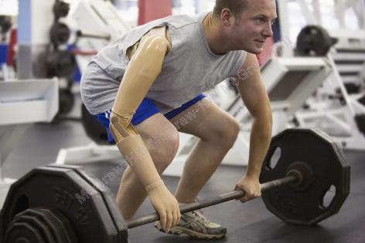
What Can You Do with Statics Knowledge?
Determine the forces that this prosthetic arm will need to withstand to make exercise possible for the wearer.
1 - <number>

Slide 6
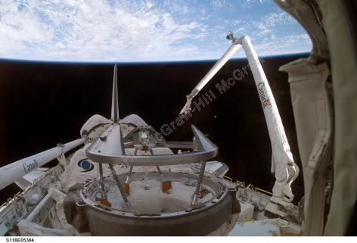
What Can You Do with Statics Knowledge?
Design the joints and support of the Shuttle Remote Manipulator System (SRMS) so that it can be used to pick up and support various payloads.
1 - <number>

Slide 7

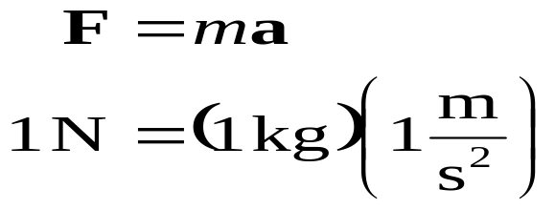
Systems of Units
Kinetic Units: length, time, mass, and force.
Three of the kinetic units, referred to as basic units, may be defined arbitrarily. The fourth unit, referred to as a derived unit, must have a definition compatible with Newton’s 2nd Law,
International System of Units (SI):
The basic units are length, time, and mass which are arbitrarily defined as the meter (m), second (s), and kilogram (kg). Force is the derived unit,
1 - <number>

Slide 8
Method of Problem Solution
Problem Statement:
Includes given data, specification of what is to be determined, and a figure showing all quantities involved.
Solution Check:
- Test for errors in reasoning by verifying that the units of the computed results are correct,
- test for errors in computation by substituting given data and computed results into previously unused equations based on the six principles,
- always apply experience and physical intuition to assess whether results seem “reasonable”
Free-Body Diagrams:
Create separate diagrams for each of the bodies involved with a clear indication of all forces acting on each body.
Fundamental Principles:
The six fundamental principles are applied to express the conditions of rest or motion of each body. The rules of algebra are applied to solve the equations for the unknown quantities.
1 - <number>

Slide 9
Numerical Accuracy
The accuracy of a solution depends on 1) accuracy of the given data, and 2) accuracy of the computations performed. The solution cannot be more accurate than the less accurate of these two.
The use of hand calculators and computers generally makes the accuracy of the computations much greater than the accuracy of the data. Hence, the solution accuracy is usually limited by the data accuracy. That is, remember what you learned about significant figures.
As a general rule for engineering problems, the data are seldom known with an accuracy greater than 0.2%. Therefore, it is usually appropriate to record parameters beginning with “1” with four digits and with three digits in all other cases, i.e., 40.0 N and 15.00 N.
1 - <number>

